Slide 1
Microsoft: Classifying Cybersecurity Incidents with Machine Learning

Slide 2
Data Preprocessing
- Memory Optimization
- Handling Missing Values
- Outliers Removal
- Feature Engineering
- Scaling Numerical Features
- Encoding Categorical Variables
- Removing Duplicate Rows

Slide 3
Memory Optimization
The script optimizes memory usage by converting data types:
- int64 to int32
- float64 to float32
- object to category

Slide 4
Handling Missing Values
The script handles missing values by:
- Dropping columns with more than 50% missing values
- Imputing categorical columns with the mode value
- Imputing numeric columns with the median value

Slide 5
Outliers Removal
The script removes outliers using the Interquartile Range (IQR) method:
- Calculates Q1 and Q3
- Computes IQR (Q3 - Q1)
- Removes data points outside the range [Q1 - 1.5*IQR, Q3 + 1.5*IQR]

Slide 6
Feature Engineering
The script extracts datetime features from the timestamp:
- Year
- Month
- Day of the week
- Hour
It then drops the original timestamp column.

Slide 7
Scaling and Encoding
The script scales numerical features using MinMaxScaler and encodes categorical variables using LabelEncoder.

Slide 8
Model Training and Evaluation
The script trains and evaluates the following models:
- Logistic Regression
- Decision Tree Classifier
- Random Forest Classifier
- XGBoost Classifier
Models are compared based on Macro-F1 Score, Precision, Recall.

Slide 9
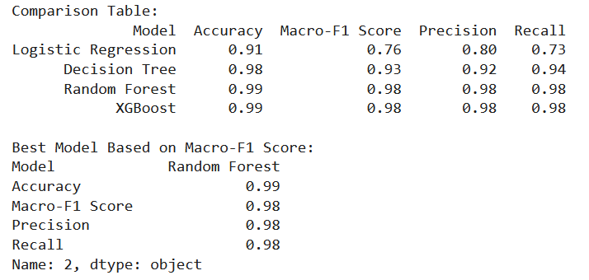

Slide 10
Feature Importance and Error Analysis
The script analyzes feature importance for the best model and identifies misclassified samples for error analysis.

Slide 11
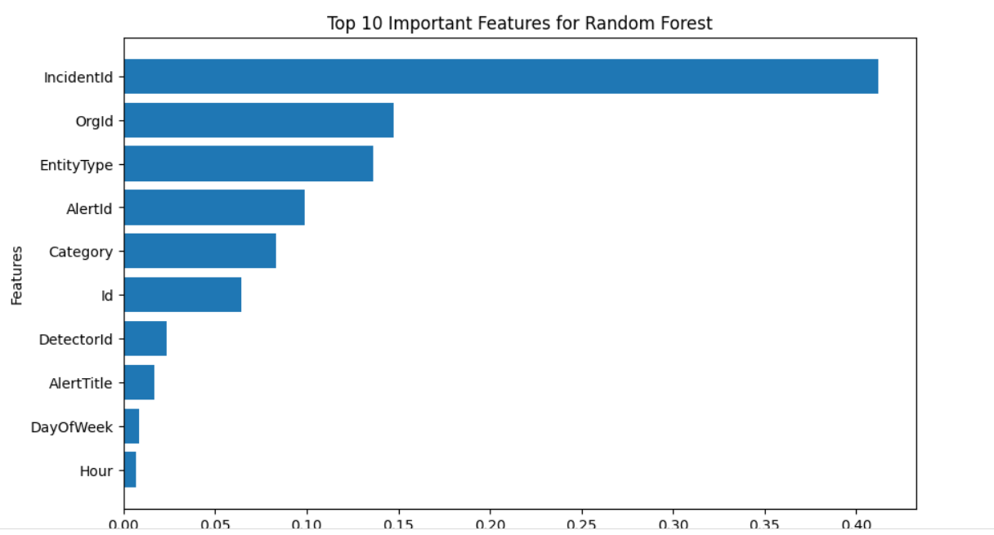

Slide 12
Model Saving and Final Evaluation
The best model is saved using joblib. The final evaluation is performed on the test dataset, reporting Macro-F1 Score, Precision, Recall, and Confusion Matrix.

Slide 13
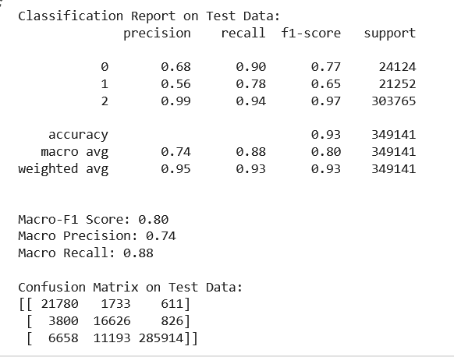
Random Forest Model Metrics on Test Data

